Slide 1

Three-Dimensional Box Topology Optimization with constrained space
Literature Review

Slide 2

Topology Optimization of Multi-component Structures via Decomposition-based Assembly synthesis (
Approach: Multi-Objective Genetic Algorithm with graph-based crossover
Highlights:
Multi-objective genetic Algorithms:
Define design variables(elements, joints), define constraints and define objective functions(which to maximize and minimize)
Create a population of solutions(chromosomes) and rank them according to the value of the objective function, saving the ones that show optimal values.
Select two chromosomes and crossover them. Afterwards, mutate the new chromosomes with a certain probability value. Evaluate the new chromosomes and update the population.
Genetic algorithms allow to tackle optimization problems with many objectives and constraints and generate optimal solution sets.

Slide 3
Genetic Algorithm
Initial Population
Fitness Function
Parent Selection
Mating Pool
Crossover
Variations
Mutation
Offspring
NO
YES
End of Generations
OR
Acceptable Result
Best Solution

Slide 4
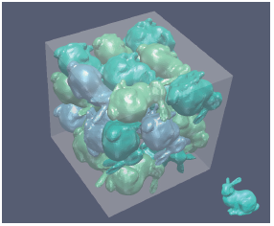
Packing Irregular Objects in 3D Space via Hybrid Optimization (Ma et al., 2018)
Literature Review
Objective: To pack as many irregular shaped objects as possible into an irregular shaped container.
Approach: Combination of (i)continuous optimization and (ii)combinatorial optimization.
Highlights:
(i) Optimize the positions and orientations of the objects
(ii) Further reduce the gaps between objects by swapping and replacing the deployed objects and inserting new objects to escape local optima
Fig 1. Packing 25 bunnies in a box with a coverage rate 45% and computational time 28 min.

Slide 5
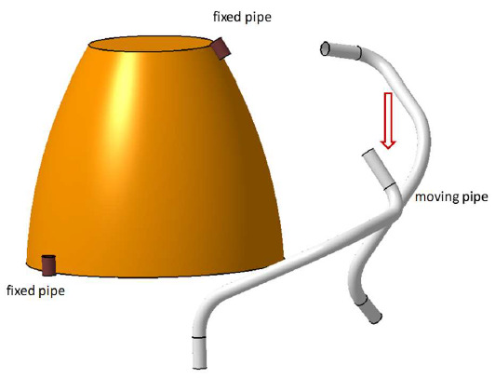
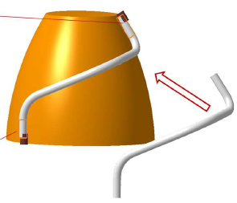
3D line matching model and optimization for rigid pipeline assembly (Li and Shen, 2019)
Objective: To match the axis lines of the ends of the moving pipe and the existing pipes; and maximize the overlap areas of each end of the moving pipe and its target on an existing pipe
Approach: Iterative Optimization algorithm
Highlights:
Matched the axis lines using an objective function that is the sum on line orientations and locations.
Used rotation matrix to minimize angular disparity between axis and translation vector to make coincident origins for both geometries.
Fig 2. The relative position of the fixed pipe and moving pipe after using rotation matrix R0
Fig 3. The final position of moving pipe after using translation matrix T0

Slide 6
Genetic Algorithm
Initial Population
A genetic algorithm is a search heuristic that is inspired by Charles Darwin’s theory of natural evolution.
Genetic Algorithms have the ability to deliver a “good-enough” solution “fast-enough”.
Able to solve optimization problems with discontinuous, non-differentiable, stochastic, or highly nonlinear objective functions..
Fitness Function
Parent Selection
Mating Pool
Crossover
Variations
Mutation
Offspring
NO
YES
End of Generations
OR
Acceptable Result
Best Solution
6
Notes:
This algorithm reflects the process of natural selection where the fittest individuals are selected for reproduction in order to produce offspring of the next generation.

Slide 7
Genetic Algorithm
Population is a subset of possible solutions to the problem.
Chromosomes is one such solution.
Gene is one element position of a chromosome.
In this Project:
Chromosomes contain the coordinates and dimensions of each component
Initial Population
Gene
A1 | .. | .. | .. | ..
A2 | 1 | 0 | 1 | 1 | 0 | 1 | 0
A3
A4 | .. | .. | .. | ..
A5
Chromosome (combination of genes)
Initial Population
(set of chromosomes)
7

Slide 8
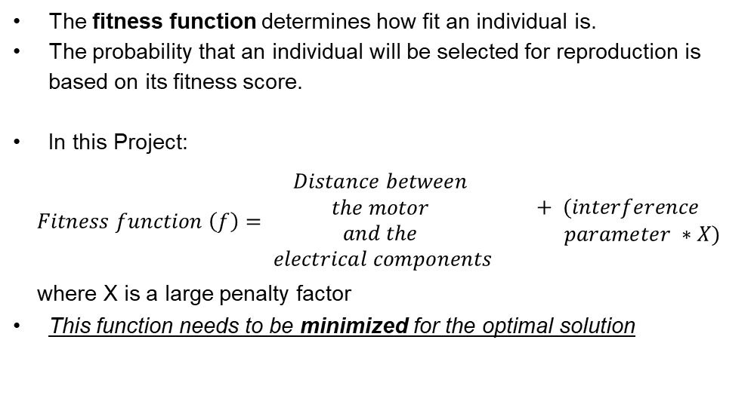
Genetic Algorithm
Initial Population
The fitness function determines how fit an individual is.
The probability that an individual will be selected for reproduction is based on its fitness score.
In this Project:
$$Fitness function \left(f\right)= \begin{matrix}\begin{aligned}Distance between \\ the motor \\ and the \\ electrical components\end{aligned} & \begin{aligned}+ (interference \\ parameter ∗X) \end{aligned}\end{matrix}$$
where X is a large penalty factor
This function needs to be minimized for the optimal solution
Fitness Function
8

Slide 9
Genetic Algorithm
Initial Population
Selecting parents which mate and recombine to create off-springs for the next generation.
Individuals with better fit have more chance to be selected.
Every two parents selected from the mating pool will generate two offspring (children).
By keeping selecting and mating high-quality individuals, there will be higher chances to just keep good properties of the individuals and leave out bad ones.
In this Project:
Individuals having smaller numerical value of fitness function (i.e. better fit) are selected a parents and mated.
Fitness Function
Parent Selection
Mating Pool
9
Notes:
The idea of selection phase is to select the fittest individuals and let them pass their genes to the next generation.
Pairs of individuals (parents) are selected based on their fitness scores. Individuals with high fitness have more chance to be selected for reproduction.
This will kill the bad individuals from generating more bad individuals.
Finally, this will end up with the desired optimal or acceptable solution.

Slide 10
Genetic Algorithm
Initial Population
By mating the parents, the new generation offspring carries genes from both parents.
The amount of genes carried from each parent may be 50% and sometimes the percent changes.
Fitness Function
Parent Selection
1 | 1 | 0 | 1 | 1 | 0 | 0 | 1
0 | 1 | 1 | 0 | 0 | 1 | 0 | 1
0 | 1 | 0 | 1 | 1 | 1 | 0 | 1
1 | 1 | 1 | 0 | 0 | 0 | 0 | 1
Mating Pool
Parents
Crossover
Variations
Crossover
Offsprings
10

Slide 11
Genetic Algorithm
Initial Population
But the offspring currently generated just have the characteristics of its parents.
Drawbacks in its parents will actually exist in the offspring.
Some changes will be applied to each offspring to create new individuals.
Fitness Function
Parent Selection
0 | 1 | 0 | 1 | 1 | 1 | 0 | 1
1 | 1 | 1 | 0 | 0 | 0 | 0 | 1
0 | 0 | 0 | 1 | 1 | 0 | 0 | 1
1 | 0 | 1 | 0 | 0 | 1 | 0 | 1
Mating Pool
Offsprings
Crossover
Crossover
Variations
Mutation
Mutation
Mutants
11

Slide 12
Genetic Algorithm
Initial Population
Fitness function of the offsprings are calculated.
It is determined whether to continue with the loop or terminate the program.
Usually, one of the following termination conditions are programmed−
When there has been no improvement in the population for X iterations.
When we reach an absolute number of generations.
When the objective function value has reached a certain pre-defined value.
Fitness Function
Parent Selection
Mating Pool
Crossover
Variations
Mutation
Offspring
NO
YES
End of Generations
OR
Acceptable Result
Best Solution
12

Slide 13
Genetic Algorithm
Initial Population
In this Project:
Chromosome | Contains the coordinates and dimensions of each component
Fitness function | Minimization of the distance between electrical components.
Constraints | Input and output shaft axis Everything inside the assembly space No collisions
Initial Population | Random position of each component, respecting the constraints.
Fitness Function
Parent Selection
Mating Pool
Crossover
Variations
Mutation
Offspring
NO
YES
End of Generations
OR
Acceptable Result
Best Solution
13

Slide 14
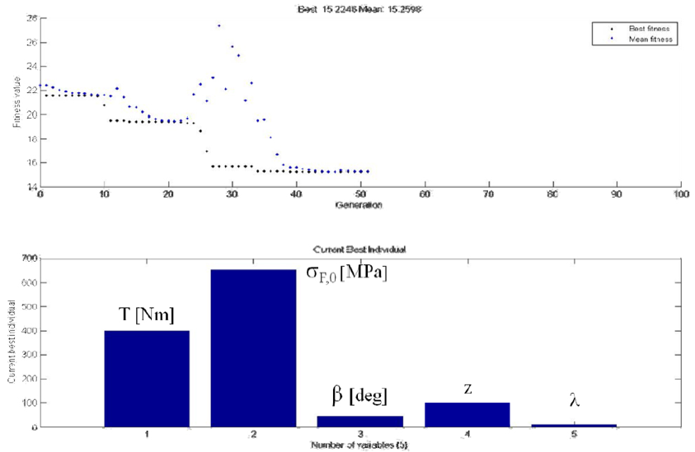
Gearbox Design by means of Genetic Algorithm and CAD/CAE Methodologies (Bonisoli et al., 2010)
Objective: To describe the optimization approach defined for evaluating the geometrical parameters related to the helical gears of a manual transmission.
Approach: Genetic algorithm
Highlights: The geometric parameters optimized were torque and speed time-histories, the required set of gear ratios and the material properties.
Fig 4. Fitness function values during the genetic optimization process (above) and final physical parameters values (below).

Slide 15
References
[1] Li, P., & Shen, Z. (2019, November). 3D line matching model and optimization for rigid pipeline assembly. In IOP Conference Series: Earth and Environmental Science (Vol. 384, No. 1, p. 012104). IOP Publishing.
[2] Ma, Y., Chen, Z., Hu, W., & Wang, W. (2018, August). Packing irregular objects in 3D space via hybrid optimization. In Computer Graphics Forum (Vol. 37, No. 5, pp. 49-59).
[3] Bonisoli, E., Velardocchia, M., Moos, S., Tornincasa, S., & Galvagno, E. (2010). Gearbox Design by means of Genetic Algorithm and CAD/CAE Methodologies (No. 2010-01-0895). SAE Technical Paper.

